Slide 1
SIT215 – Artificial and Computational Intelligence
Problem solving task 4 – Genetic Algorithms
Lee Copland
Philip Castiglione

Slide 2
How Genetic Algorithms work
Optimisation technique based off evolutionary natural selection
Map data to a chromosome comprised of genes
Breed a new generation using the best chromosomes of the previous generation
Uses mutation, crossover and selection in new generations to stochastically improve fitness across the population of solutions

Slide 3
Skills Audit
Skill | Level of knowledge (None, Basic, Competent, Proficient) | Action(s) to improve
Problem Domain: Optimisation | Lee: Basic Phil: Competent | Introduction to Genetic Algorithms https://www.whitman.edu/Documents/Academics/Mathematics/2014/carrjk.pdf ^{[1]}
Finding a suitable dataset | Lee: Basic Phil: Competent | https://www.kaggle.com/datasets
Genetic algorithm theory | Lee: None Phil: Basic | Genetic Algorithm Theory – Lecture notes from Johannes Kepler University http://www.flll.jku.at/div/teaching/Ga/GA-Notes.pdf ^{[2]}
Genetic algorithm application | Lee: None Phil: Competent | Genetic Algorithms tutorial in Python https://blog.sicara.com/getting-started-genetic-algorithms-python-tutorial-81ffa1dd72f9 ^{[3]}
Data cleaning | Lee: Basic Phil: Proficient | Data cleaning 101 https://towardsdatascience.com/data-cleaning-101-948d22a92e4 ^{[4]}

Slide 4
Solution Challenges
Optimisation Problem
Find a problem suitable for optimisation
Find a dataset
Performance tracking and measurement
Genetic Algorithm Challenges
Representation of the dataset
Genetic Algorithm design and implementation
Hyperparameter settings

Slide 5
Our Solution
Genetic Algorithms are a class of evolutionary algorithms used for solving optimisation problems.
They require data to be encoded with particular structure.
We apply a Genetic Algorithm to optimise the weights in a linear equation for predicting medical insurance costs using a dataset from Kaggle^{[5]}.

Slide 6
Our Solution
Prepare and setup GA
Map categorical features Normalise continuous features Normalise labels Initialise population
Parent selection and breeding
Two approaches:
Offspring production
Crossover Mutation
Application of Fitness
Cull weakest chromosomes in selection of next generation Continue evolution with next generation
Stochastically select based on weightings
Select fittest
Couple parents
Track progress

Slide 7
Demonstration

Slide 8
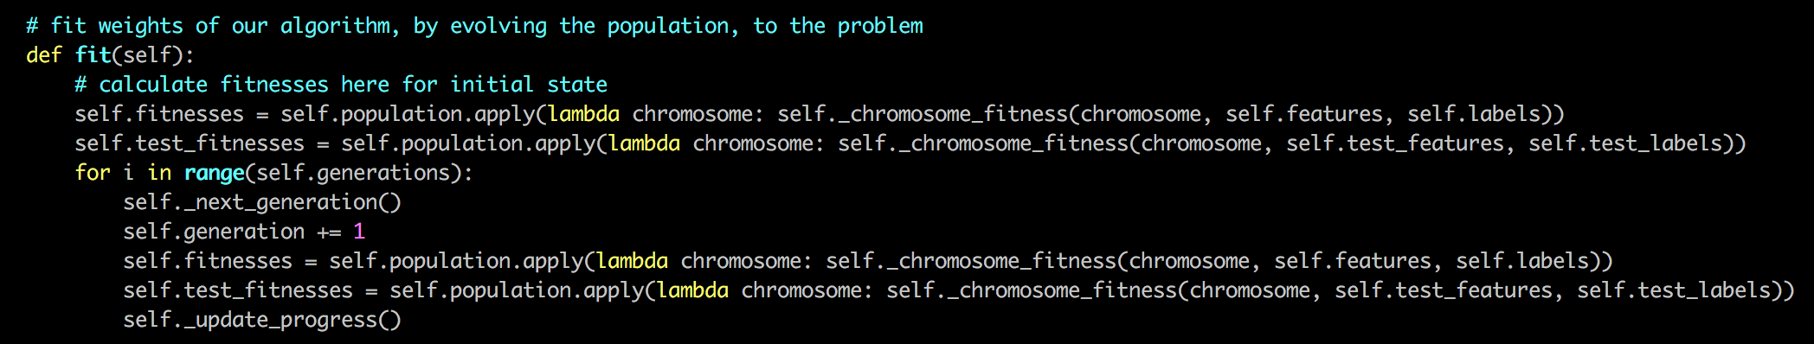
Code snippets - 1

Slide 9
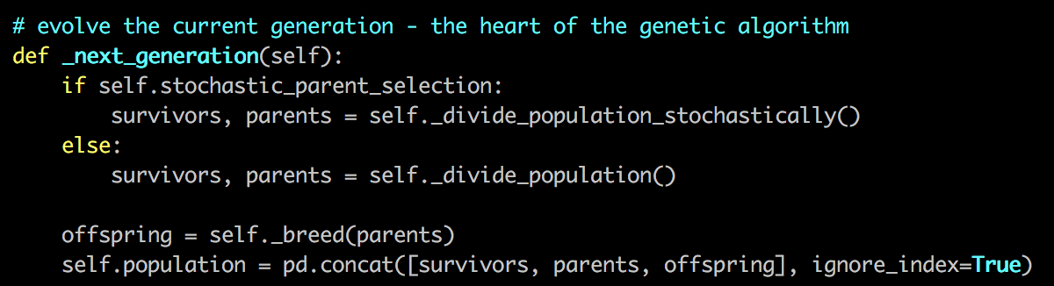
Code snippets – 2

Slide 10
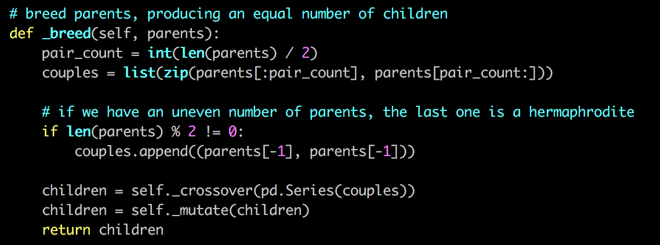
Code snippets – 3

Slide 11
Limitations and constraints
Prediction accuracy is modest
Linear equation may not be the best suited prediction model for the problem
No automatic stopping; # of generations is a hyperparameter
Gridsearch over the whole hyperparameter space is computationally expensive

Slide 12
References
[1] – Carr, J. (2014). An Introduction to Genetic Algorithms. [online] Whitman.edu. Available at: https://www.whitman.edu/Documents/Academics/Mathematics/2014/carrjk.pdf [Accessed 10 Sep. 2018].
[2] – Bodenhofer, U. (2003). Genetic Algorithms: Theory and Applications. [online] Flll.jku.at. Available at: http://www.flll.jku.at/div/teaching/Ga/GA-Notes.pdf [Accessed 10 Sep. 2018].
[3] – Nicolle, L. (2017). Getting started with genetic algorithms: a tutorial. [online] Sicara's blog. Available at: https://blog.sicara.com/getting-started-genetic-algorithms-python-tutorial-81ffa1dd72f9 [Accessed 10 Sep. 2018].
[4] – Bailey, B. (2017). Data Cleaning 101 – Towards Data Science. [online] Towards Data Science. Available at: https://towardsdatascience.com/data-cleaning-101-948d22a92e4 [Accessed 15 Sep. 2018].
[5] – https://www.kaggle.com

Slide 13
Conclusion
Repository for the program and related documents is located here:
https://github.com/PhilipCastiglione/SIT215_PBL4
Thanks for watching!

